Slide 1

National Data Center
2014 User Conference

Slide 2
Introductions
David Shapiro, NDC: Introductions, Information Authorization, Deep Linking
David Snapp, NDC: NDC web services API, Database Expansion, Multi-Trustee Voucher,
Loren Smith, NDC: ndc.org en Español, NDC free Excel demo app
Break
Marty Quinn, Bankruptcy Software Solutions: Plan Calc
David Richards, Resurgent
Bill Taylor, 4S Technologies: Using NDC Data for Compliance
David Shapiro, NDC: Wrap-up & NDC futures
Completing the NDC Team: Mary Ruppenthal - Chief Administrator; Olivia Herrick – Customer Liaison; Allen Exelbierd – Finance; and George Stevenson, CEO. NDC Board members – Raise your hands!

Slide 3
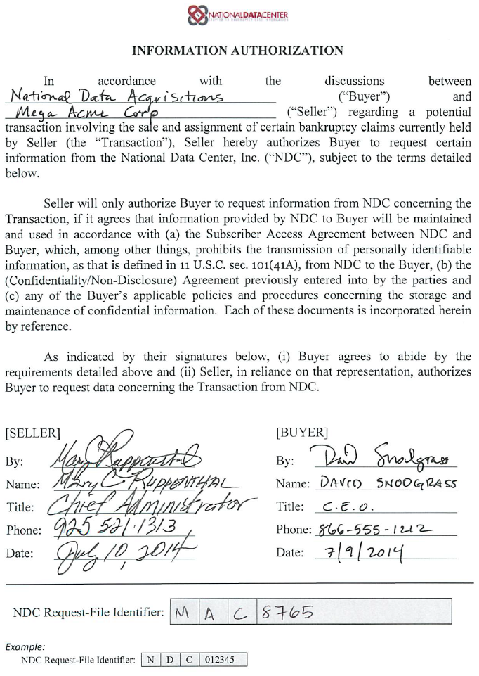


NDC Information Authorization Form
Now required for any NDC service where you are not the party-in-interest and/or using NDC data for a buyer/seller transaction.
  Located at https://www.ndc.org/Downloads (homepage>Downloads)>”NDC Request File Authorization”
  Use the NDC RFI Number in the filename of your submitted Request File.
  For multiple buys from same seller, only one form
NDC Request File
NDCRFI_MAC8765_Buy1.txt

Slide 4
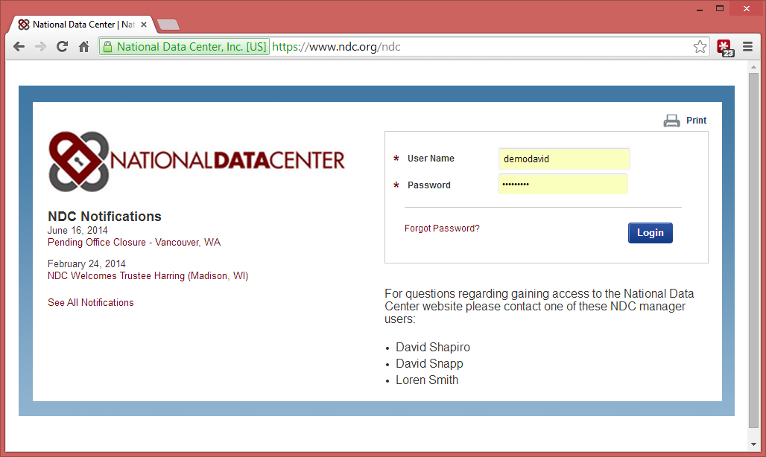
Branded Landing Pages
Create a branded landing (login) page for your team
Custom URL
Your logo1
Custom text and messaging

Slide 5
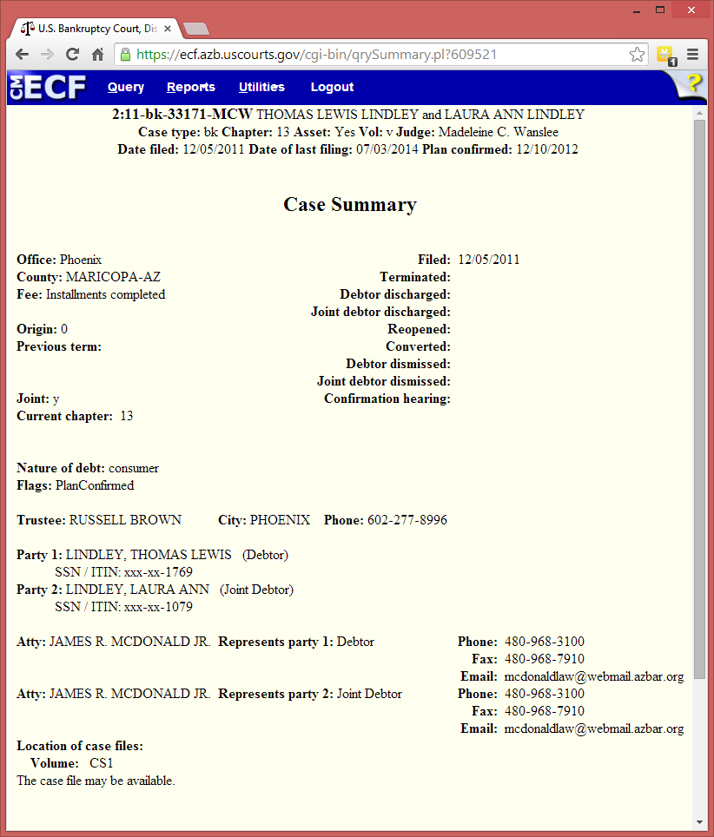
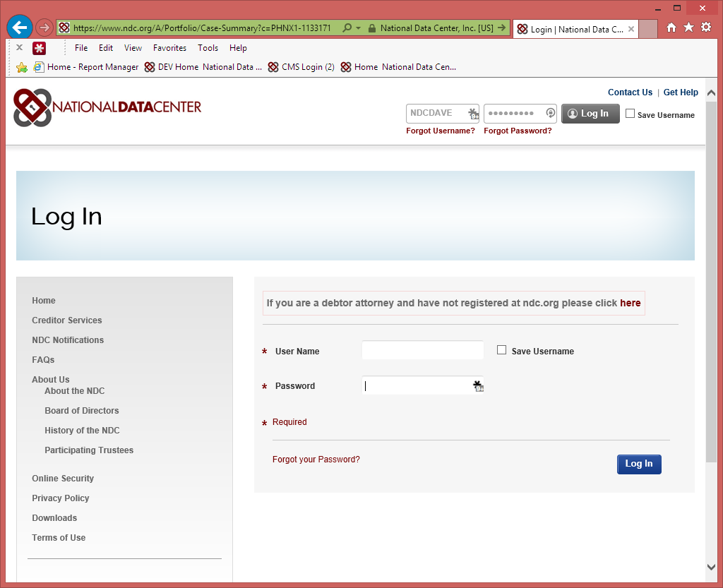
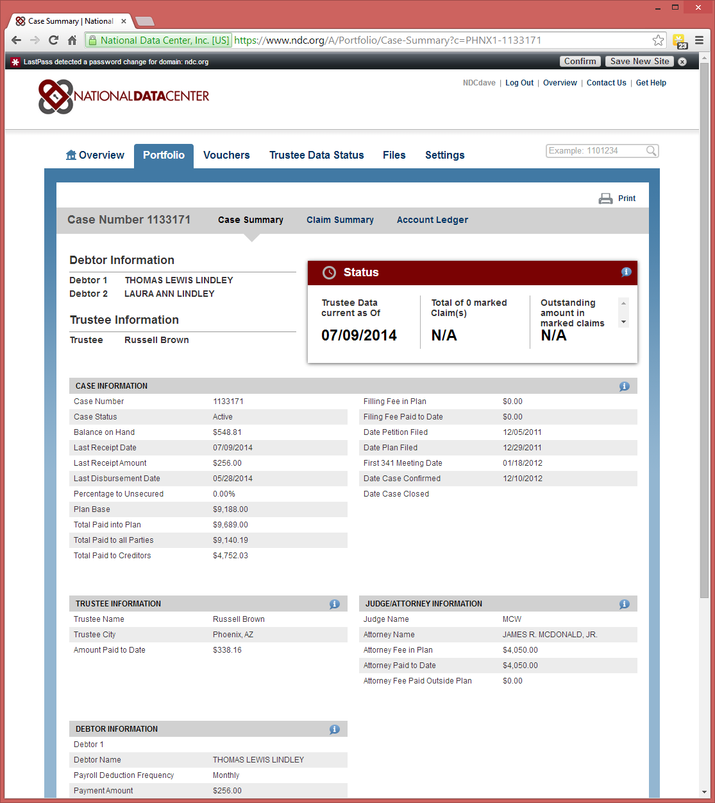
Deep Linking
Integrate your intranet applications with NDC.org
Every Case can be accessed by a NDC_CASE_ID, every claim can be accessed by a NDC_CLAIM_ID.
NDC Case Identifier: <TrusteeID>-<CaseNumber>
NDC Claim Identifier: <TrusteeID>-<CaseNumber>-<NDCClaimNum>-<ReferenceNum>
Sample HTML: <a href="https://www.ndc.org/A/Portfolio/Case-Summary?c=PHNX1-1133171">NDC Case Link</a>
Only sign in once, subsequent link clicks do not require authentication (until session time out)
NDC Case Link

Slide 6

Technical Roadmap
Dave Snapp
dsnapp@ndc.org

Slide 7
Projects in the Works
Multi Trustee Voucher Download (string match)
Trustee Data Expansion
Data Load Changes
Subscriber Reports
Increase web service usage and add new web services

Slide 8
Multi Trustee Voucher Download
Search for Vouchers that pertain to your claims only
Requires that you us String Match to build your portfolio
Search for vouchers by Date Range or single check number for one or more Trustees
Demo

Slide 9
Trustee Data Expansion
Working with our data providers to obtain more data elements
Once we get updated data feeds we will determine how to present the data on the site/web services
  New pages
  Changes to existing pages
  Enhancements to String matching
Examples of new data items we want to get:
  Claims Bar Date and/or Bar Date Indicator
  Delinquency information (how long and how much)
  Additional Creditor Contact information
  Additional Plan Step data (case payment schedule)
  Claim pay down schedule

Slide 10
Trustee Data Load Improvements
Currently we load trustee data once a day in the middle of the night
Currently we fully refresh a trustee’s data each day.
Working towards doing a real time update of the data. When we receive the data we want to update the site right away.
Improve the data loading to update a trustee’s data rather than fully refresh.
Track changes to a case/claim and highlight those changes on the site.

Slide 11
Subscriber Reports
Build Reporting Dashboard for your organization
Case/Claim daily or weekly reports
Voucher daily or weekly reports
User Management or Activity tracking reports
Looking for suggestions/feedback on what useful reports you would like to see

Slide 12
Web Services
New and efficient way to access data at the NDC
You can call the Web Services in many ways (custom client application, database code, ETL Tools, Excel, etc..)
Web Services allow you to automate your data gathering and integrate with your current business processes

Slide 13
ndc.org Web Service APIs
Our web service APIs offer the same data that our various web pages provide.
The current APIs available include:
Portfolio List
Trustee List
Voucher Download
Request File (new)
Case (with or without claim and/or ledger data)
Claim
Account Ledger
AddCase (new)
Find details about the various NDC APIs at:
https://api.ndc.org/help

Slide 14
Excel Web Service API Tools
Access ndc.org Web Service API data using Microsoft Excel.
Benefits:
No programming knowledge required
Data automatically structured in a user-friendly tabular format
Unrestricted access to backend (VBA) code allows for customization

Slide 15
NDC.org in Spanish
Debtor facing pages will now have professionally translated Spanish text.
Detection of current browser language settings
Ability to toggle Spanish translation on or off
Further supporting increased debtor usage

Slide 16
NDC – In Summary
Deep Linking
Authorization Form/Request File Identifier
Let us know if you’re interested in a Landing Page
Rollout of MultiTrustee Download
Download a copy of the free NDC Excel API Demo
Check out our new APIs for updating your portfolio and Request Files
Let us know if there’s a data item to include our data model expansion
What would you like NDC 2.0 to look like?

Slide 17
Wrap Up & Futures
Conference slides will be available on-line
Don’t forget to pickup your NDC T’s
Any questions please email us
  david@ndc.org
  dsnapp@ndc.org
  loren@ndc.org

Slide 18
Big Thanks to our guest presenters
  Marty from BSS
  Dave from Resurgent
  Bill from 4S
Thanks again for attending the NDC User Conference 2014

