Slide 1

National Data Center
2015 User Conference

Slide 2
Introductions
David Shapiro, NDC: Introductions, Information Authorization, Docket-Link, new Claim Summary interface, Servicer Landing page and Email Notifications
David Snapp, NDC: Database Expansion, Claim Tags, Custom Voucher Download Formats, Portfolio Vouchers (formerly Multi-Trustee Voucher), Updated APIs,
Loren Smith, NDC: New and Improved FTP Web Portal
Bill Taylor, 4S Technologies: Mortgage Liaison Committee Update
David Shapiro, NDC: Wrap-up & NDC futures
Completing the NDC Team: Mary Ruppenthal - Chief Administrator; Olivia Herrick – Customer Liaison; Allen Exelbierd – Finance; and George Stevenson, CEO. NDC Board members – Raise your hands!

Slide 3
NDC Ninja 2.0

Slide 4
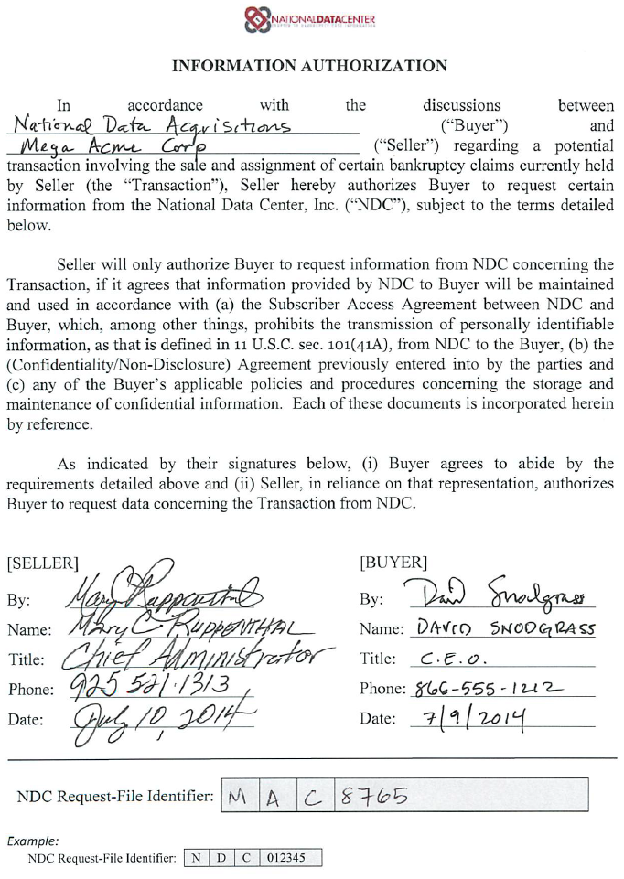


NDC Information Authorization Form
Now required for any NDC service where you are not the party-in-interest and/or using NDC data for a buyer/seller transaction.
  Located at https://www.ndc.org/Downloads (homepage>Downloads)>”NDC Request File Authorization”
  Use the NDC RFI Number in the filename of your submitted Request File.
  For multiple buys from same seller, only one form
NDC Request File
NDCRFI_MAC8765_Buy1.txt

Slide 5
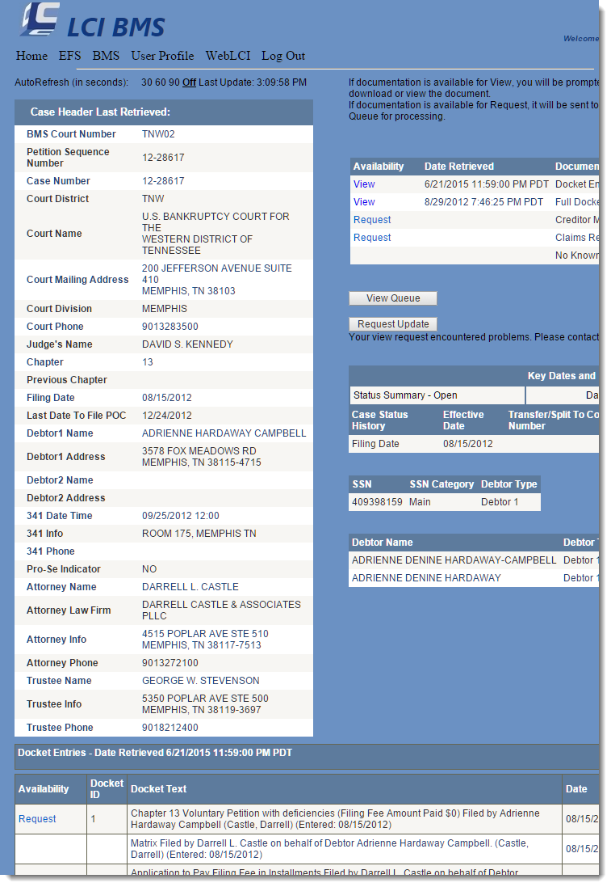
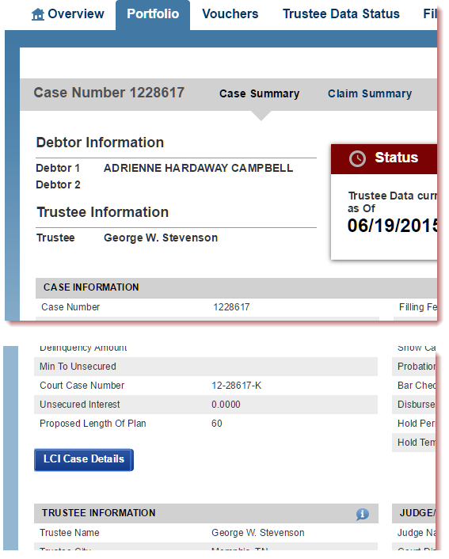
Docket-Link LCI/BMS Integration
A new way to link NDC to LCI for court document lookup
Link button to LCI/BMS

Slide 6
Demo
Docket-Link LCI/BMS Integration

Slide 7
Docket-Link LCI/BMS Integration
Pricing Matrix:
Package | NDC Configuration | LCI Configuration | Cost
Docket-Link BYO | Provide your existing LCI credentials, we will configure in the back end | Normal LCI/BMS controls | $0
Docket-Link On Demand* | We’ll configure an account-wide LCI user | Nothing | LCI costs plus 20%. Billed Monthly.
*
NDC will setup a unique LCI user that will track all activity within the LCI system. Your monthly NDC statement will reflect the LCI activity.
2 day setup

Slide 8
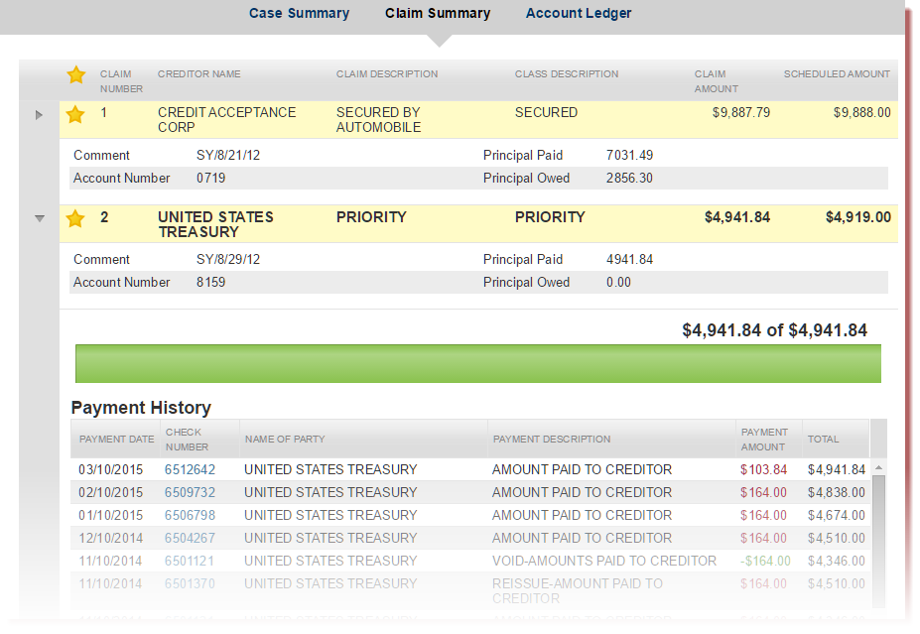
Drag N Drop Claim Summary
A reimagined way to view claims
Drag & Drop functionality
Key fields in easy to read format
Important Ledger information in a drop-down
New progress bar

Slide 9
Demo
Drag n Drop Claims Summary

Slide 10
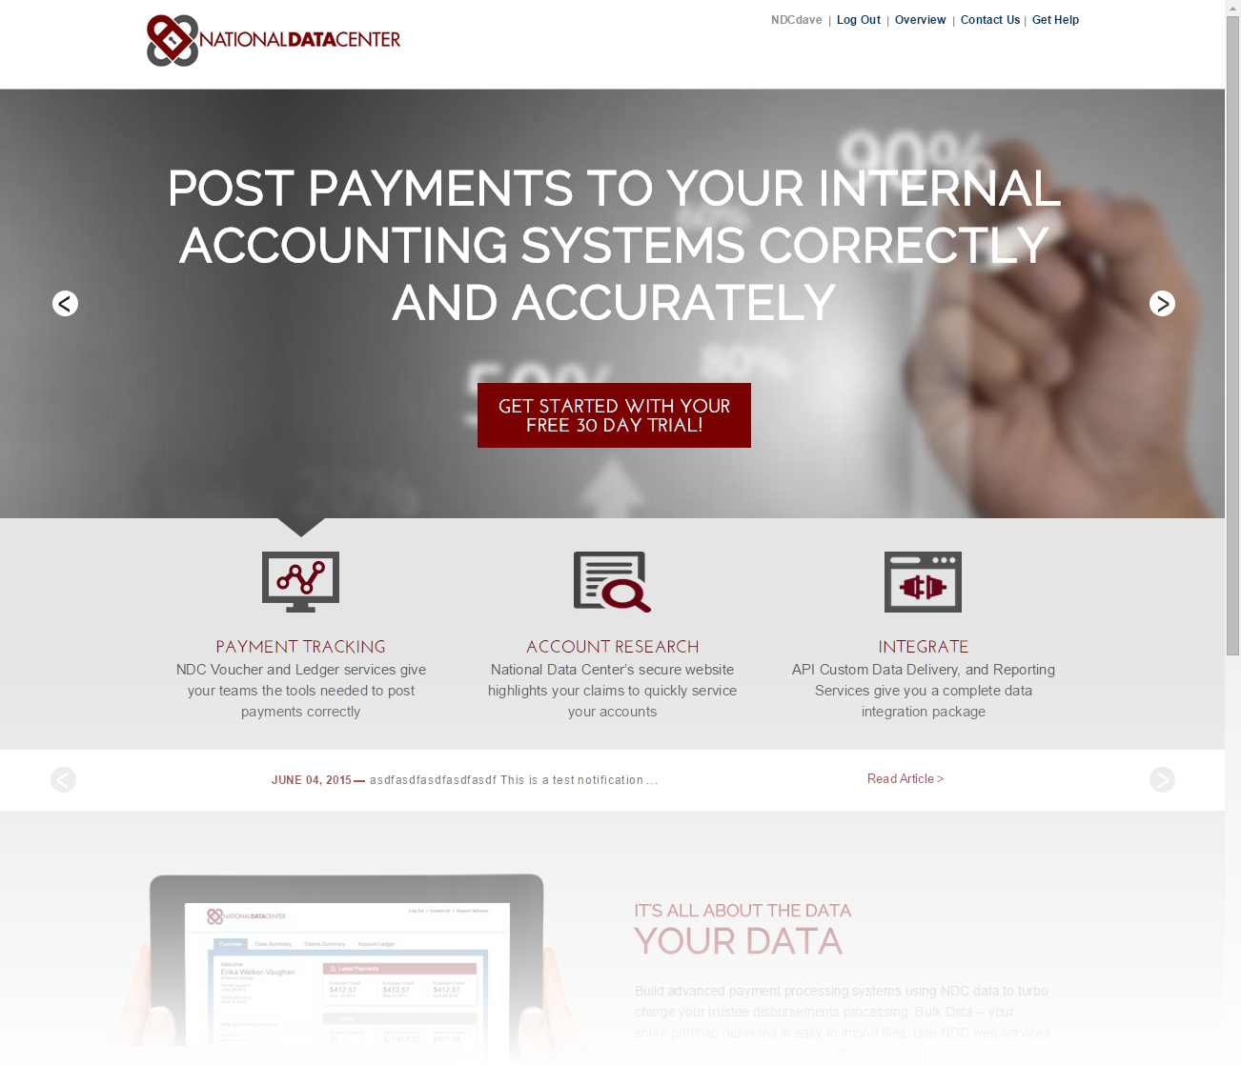
Servicer Landing Page
New Landing page for all Servicers and Creditors
Fancy new notifications area

Slide 11
Demo
Servicer Landing Page

Slide 12
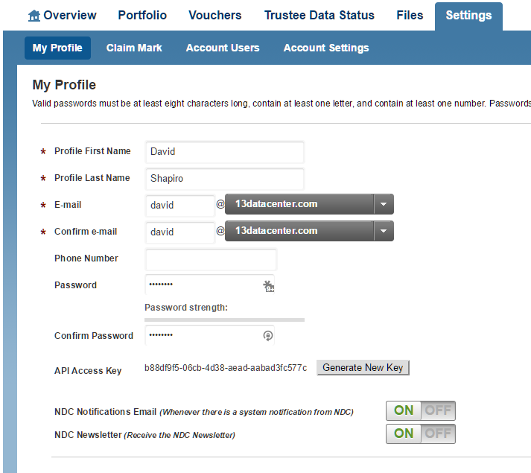
Email Notification Subscriptions
New Email Notification Options:
NDC Notifications: Any notice that would be posted to the front page will be emailed to you
NDC Newsletter: We’ll be improving our communication with you in 2015! Semi-annual newsletters with tips and tricks and important dates in the NDC/13 world

Slide 13
David Snapp

Slide 14
Trustee Data Expansion
Currently we are working with our data providers (BSS, EPIQ, Satori, CMC, etc..) to obtain new data elements.
Rollout changes to ndc.org in late July
  New Pages
  Changes to existing pages
  Enhancements to how we determine if a creditor is a party in interest on a case.
Updated versions of our web services are now available.

Slide 15
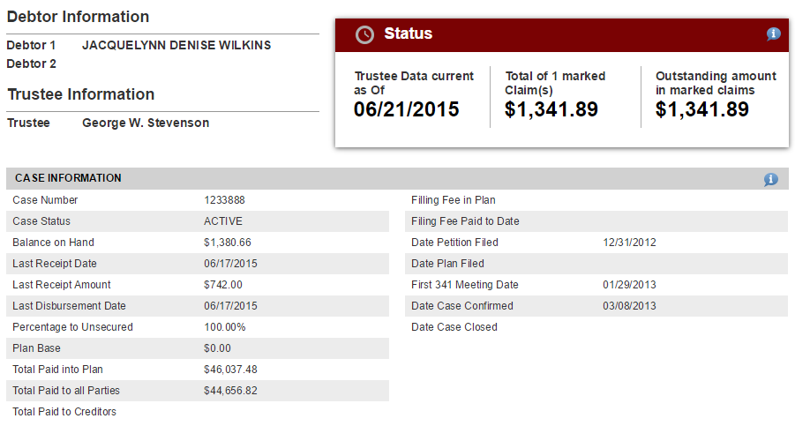
Trustee Data Expansion
Case Summary - Case Information

Slide 16
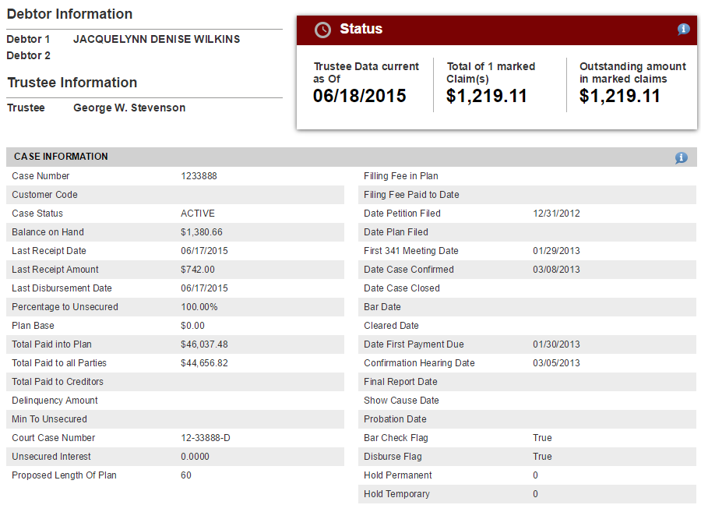
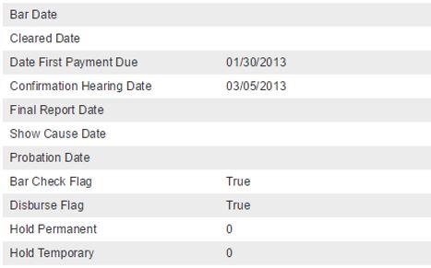
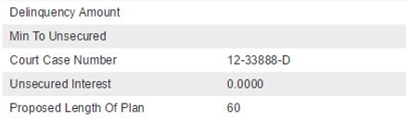
Trustee Data Expansion
Case Summary - Case Information

Slide 17
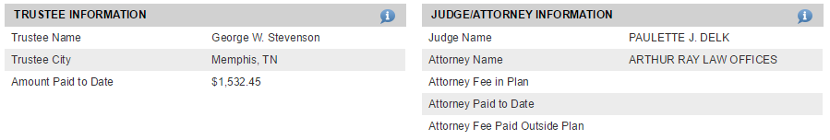
Trustee Data Expansion
Case Summary – Judge/Attorney Information

Slide 18

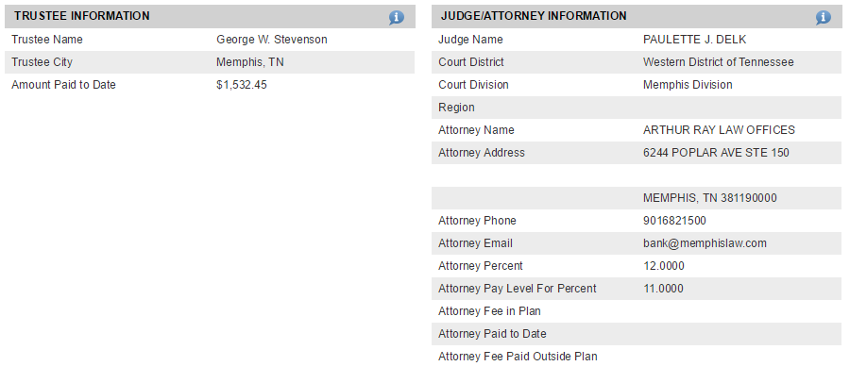
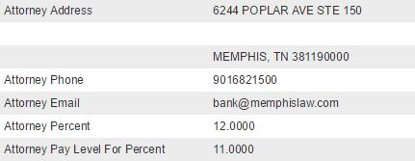
Trustee Data Expansion
Case Summary – Judge/Attorney Information

Slide 19
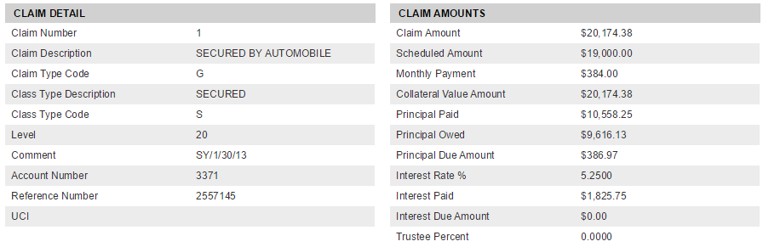
Trustee Data Expansion
Claim Detail

Slide 20
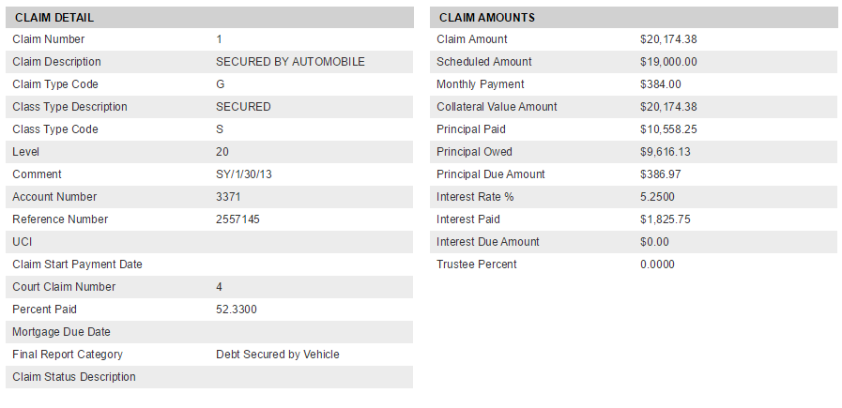
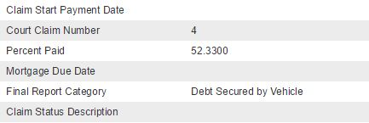
Trustee Data Expansion
Claim Detail

Slide 21
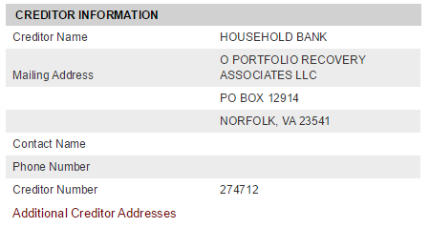
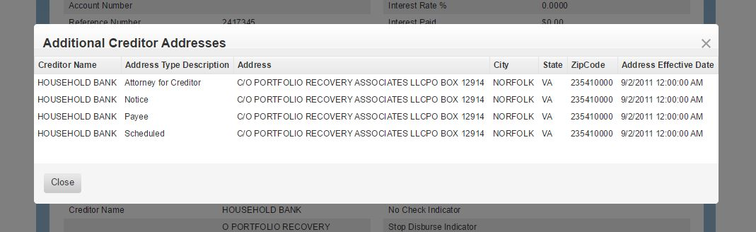
Trustee Data Expansion
Claim Detail – Additional Creditor Addresses

Slide 22
Trustee Data Expansion
Trustees are currently being converted to our updated data feed.
  All Satori Trustees
  70% BSS Trustees
  EPIQ Trustees TBD
If more data elements become available we will post notifications to our homepage.
Full updated Data Dictionary available on our “Downloads” page.
https://www.ndc.org/downloads

Slide 23
Customer Claim Tags
Payment Type Tag
dropdown list of values
  Post Petition Arrearage
  Agree Order
  Pre Petition Plan
  506 Modification
  Ongoing Mortgage
  Liquidation Claim
  Other
Comment Text Tag
100 character text value
  Enter any text Tag you want
Claim Identifier Tag
50 character text value
  Defaults to the redacted account number present on the claim

Slide 24
Customer Claim Tags
Claims Tags are specific to your organization
  Only users within your company can see the tags you create
You can retrieve the Claim Tags
  In the Voucher Download output on ndc.org
  In the Claims3 and Voucher2 web service api
Can search for Claims by Claim Tag Account Number using api
One Active set of Tags at a time
We do track changes to the Claim Tags
DEMO Claim Tag on “Claim Detail” page

Slide 25
Customer Claim Tags
Rolling out the UI change to the Claim Detail page in Late July
New web service apis to set and retrieve Claim Tags are available now

Slide 26
Custom Voucher Download Format
Historically the Voucher Download files have been formatted the same for everyone
Have had requests to add/remove columns for particular organizations
We can now accommodate custom download format for your organization
Requires some manual setup on our end and will effect all voucher download files made by your users

Slide 27
Portfolio Vouchers
Formally known as “Multi-Trustee Voucher Download”
Allows you to search and download Vouchers specific to your organization from one or many trustees
More efficient than the traditional Voucher download page
Requires you to be a “String” (term match) portfolio customer
There is a new api available for this feature
DEMO Voucher UI

Slide 28
NDC Web Service APIs
NDC has tripled our API usage in the past six months
A total of 3.6 million apis calls were done in the past year
More than doubled the number of customers using the apis in the past year
  9 customers in 2014
  22 customers in 2015
If you want a full API demo please contact us
https://api.ndc.org/

Slide 29
NDC Web Service APIs
Added New versions of the following apis with additional data elements in the response
  Cases3
    added data expansion fields
    added new optional parameter for plan step data
  Claim3
    added data expansion fields
    added customer claim tag fields
  Voucher2
    added data expansion fields
    added customer claim tag fields
https://api.ndc.org/

Slide 30
NDC Web Service APIs
Created new apis
  PlanSteps
    Returns the Plan Payment Steps a specific Case by its Case ID
  UpdateClaimTags
    Inserts/Deletes Claim Tags for a given NDC_Claim_ID. Returns SUCCESS or FAILURE result and the NDC_Claim_ID affected.
  ClaimsByClaimTagAccountNumber
    Returns a specific Claim by its Claim Tag Account Number. You can add Claim Tags using the "UpdateClaimTags" api.
  Voucher/PortfolioVoucher
    You can search by PaymentDT or CheckNumber.
    Will search for vouchers for all trustees that pertain to Claims that we have identified you are a party in interest on
https://api.ndc.org/

Slide 31
Loren Smith

Slide 32
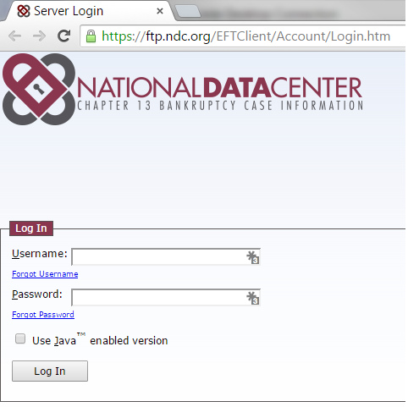
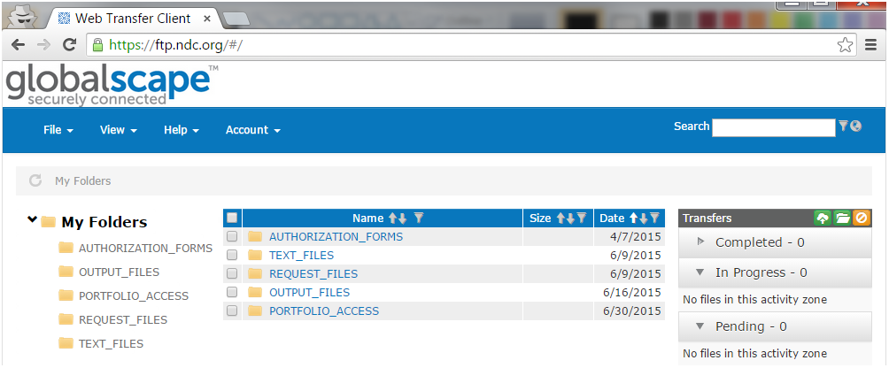
FTP Web Portal
New and Improved FTP Web Portal Interface
Demo FTP Portal

Slide 33
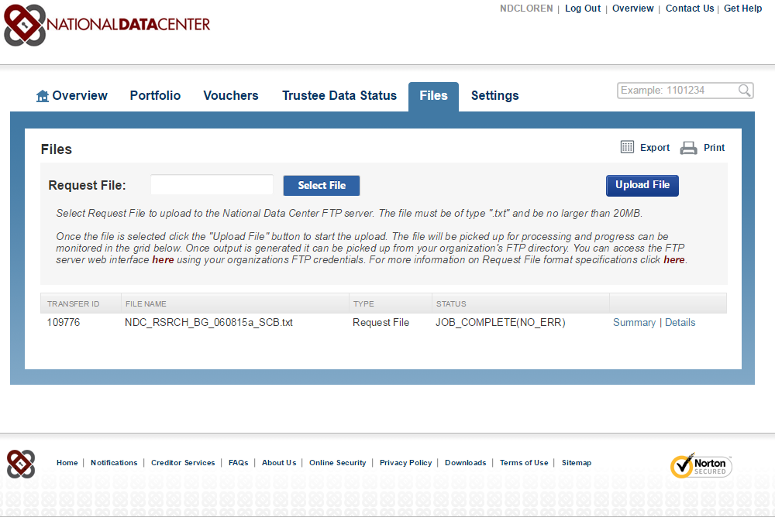
FTP Web Portal
New NDC.org Feature – Ability to Upload Request Files
Demo Request File upload button

Slide 34
Ninja 2.0 – Build your App today!
Use Claim Tags to augment your NDC Claims data with your custom IDs, comments and claim types
  Team members can more easily classify claims if someone has setup the tags
  Use the API to update en mass
Build automation around the new Voucher Formats to download files that feed directly into your accounting systems with Claim Tags included
  Makes your accounting systems smarter with less errors
Integrate your in-house systems with NDC APIs
  All kinds of possibilities, in fact you can build completely new apps that don’t use the website at all.

Slide 35
NDC – Ninja 2.0 In Summary
Docket-Link
New Claim Summary interface
Servicer Landing page
Email Notifications
Database Expansion
Claim Tags
Custom Voucher Download Formats
Portfolio Vouchers (formerly Multi-Trustee Voucher)
Updated APIs
New and Improved FTP Web Portal
Check out our new APIs for updating your portfolio and Request Files
Let us know if there’s a data item to include our data model expansion

Slide 36
Ninja 2.0 – Rollout Plan
Package | Beta Release | Production Release
Updated APIs |  | Available Now
Data Expansion | July 2015 | Aug 2015
Claim Tags | Aug 2015 | September 2015
Voucher Styles |  | Available Now
LCI Integration | Aug 2015 | September 2015
Servicer Landing Page | July 2015 | August 2015
Drag N Drop Claim Summary | Aug 2015 | September 2015
Email Subscriptions | Sept 2015 | October 2015
FTP Web Portal | July 2015 | August 2015

Slide 37
Ninja 2.x Futures
Reporting and Analytics data: design your own reports or download formats for data.
Analytics: create a payout estimator for claims
Docket-Link with other systems, AACER, LexisNexis Banko, etc
What would you like to see?

Slide 38
Wrap Up
Conference slides will be available on-line
Any questions please email us
  david@ndc.org
  dsnapp@ndc.org
  loren@ndc.org
Come see us @ Demo Tables
Drinks – bring one for us, we need it.

Slide 39
Big Thanks to our guest presenter:
  Bill Taylor - 4S
Thanks again for attending the
NDC User Conference 2015
(see you next year in Philly)

